Slide 1
Jermyn Borough Council Meeting
4/28/22

Slide 2

Meeting Agenda
April 28,2022
CALL TO ORDER
PLEDGE OF ALLEGIANCE
ROLL CALL
PREVIOUS MEETING MINUTES
TREASURER REPORT/BILLS PAYABLE
CORRESPONDENCE -
PUBLIC COMMENT
PROFESSIONAL REPORTS
POLICE
FIRE
EMA
SOLICITOR
CODE ENFORCEMENT
ZONING
ENGINEER
TAX COLLECTOR
MAYOR
COMMITTEE REPORTS
POLICE PENSION ORDINANCE
FLOODPLAIN CONSISTENCY LETTER
COAL MINER CORNER TAX ISSUE
NEW BUSINESS

Slide 3
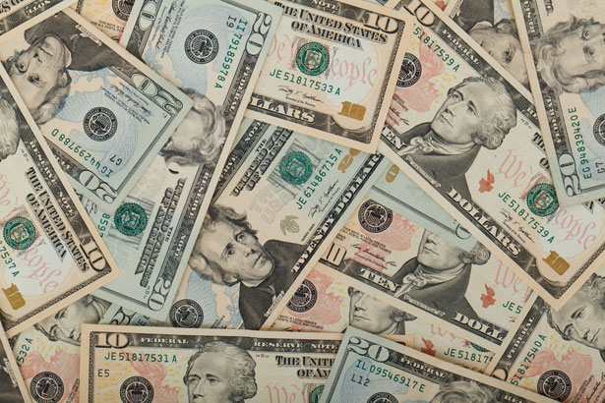
Treasurer’s report
4/28/22
ASSETS
Checking/Savings
Capital Reserve - DPW 10,726.47
Capital Reserve - Police 4,651.82
Crime Watch Fund 222.69
General Fund - Community 231,159.02
General Fund - FNB 4,731.87
Holiday Lights Fund 1,374.09

Slide 4
Treasurer’s report
Investment - General Fund 1,001.63
Investment - Liquid Fuels 33,817.53
Investment - Paving Fund 1,012.02
Investment - Recycling 5,003.93
Investment - Refuse 2,600.48
Liquid Fuels - FNB 62,254.02
Petty Cash 231.00
Recreations Fund 19,007.14
Recycling - Community 10,063.44
Refuse Checking - FNB 69,017.63
Total Checking/Savings 456,874.78

Slide 5
Treasurer’s report
200000 · Accounts Payable 33,182.91
Long Term Debt 328,781.45

Slide 6
MS4 Minute
https://youtu.be/6WEg292OuiQ

Slide 7


